Slide 1
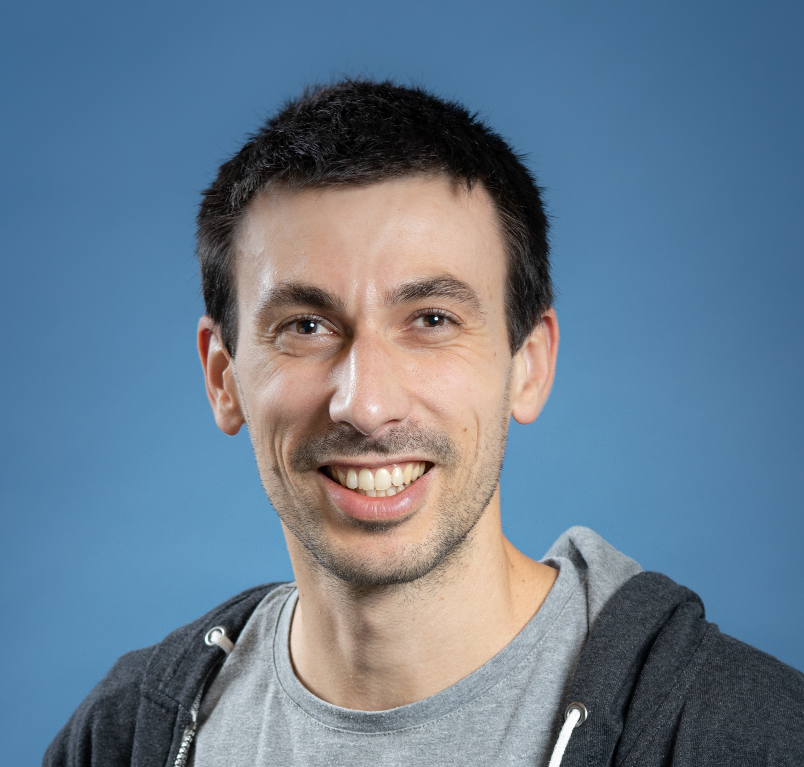



Le MLOps est avant tout une aventure humaine
Guillaume Chervet
TechLead – ML Engineer
Direction Transfo et Tech - AXA France
@guiChervet
Octobre 2023
Notes:
What is MLOps? This is all things that will help and support the fact of bringing artificial intelligence algorithms into production, it is not about tools or technologies; it is mainly a question of culture and good practice.
Hi, my name is Guillaume Chervet, I'm an ML engineer at AXA France. Basically, I define my role as helping data scientists to bring AI algorithms into production.
I‘m part of a team that works on real-time automatic document understanding projects. Generally, this kind of projects implements one or more Deep Learning algorithms.
Today, almost 80% of projects fail at the production stage. This does not surprise me because, this kind of projects are on the top complexities in all areas, all factors are met to make them fail.

Slide 2
Today Agenda
Recipes to fail an ML project
How to stack the odds in your favor ?
Notes:
In this part we are going to give feedbacks based on different experiences. This allowed us to learn what NOT to do.
To make it fun, we are going to open a pizzeria and we are going to organize to serve pizzas to our customers. We're going to put everything in place to make our pizzeria fails to deliver a good meal.

Slide 3
Today Agenda
Recipes to fail an ML project
How to stack the odds in your favor ?
Notes:
In this part we are going to give feedbacks based on different experiences. This allowed us to learn what NOT to do.
To make it fun, we are going to open a pizzeria and we are going to organize to serve pizzas to our customers. We're going to put everything in place to make our pizzeria fails to deliver a good meal.

Slide 4
Recipes to fail
Exploration
Industrialization
Deployment & run
Project timeline
Le MLOps est une aventure Humaine – Devoxx France 2023 – Guillaume Chervet
Notes:
To start, we will organize our team. In an AI project, there are 3 main phases. The first phase is the exploration phase, we will test if the project is feasible, then we move on to an industrialization phase and finally we have a “Deployment and Run” phase.
So here, I present to you Elisabeth, Elisabeth is a Data Scientist. We asked her to work alone on the exploration phase.

Slide 5

Recipes to fail
Exploration
"Data scientist girl who cook with a suit in a kitchen, artstation concept art"
Project timeline
Le MLOps est une aventure Humaine – Devoxx France 2023 – Guillaume Chervet
Notes:
To start, we will organize our team. In an AI project, there are 3 main phases. The first phase is the exploration phase, we will test if the project is feasible, then we move on to an industrialization phase and finally we have a “Deployment and Run” phase.
So here, I present to you Elisabeth, Elisabeth is a Data Scientist. We asked her to work alone on the exploration phase.

Slide 6
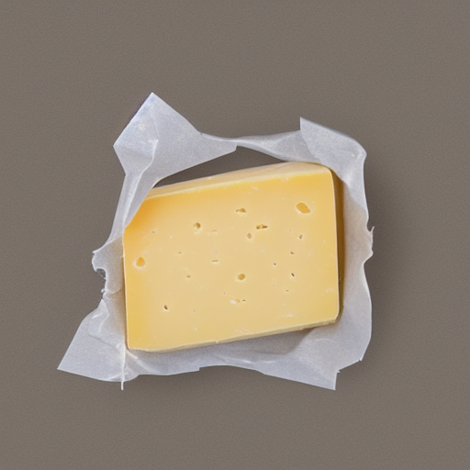


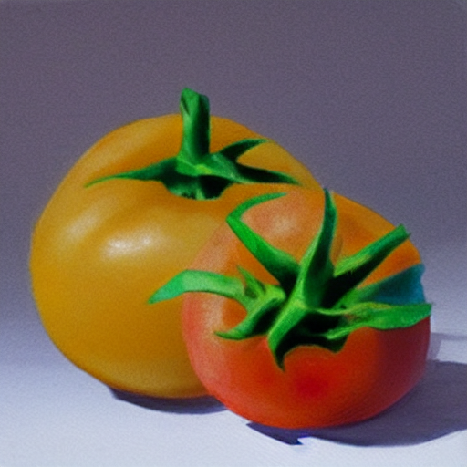
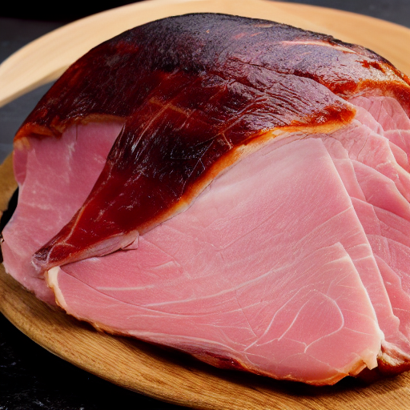
Recipes to fail
Exploration
"Data scientist girl who cook with a suit in a kitchen, artstation concept art"
Project timeline
Le MLOps est une aventure Humaine – Guillaume Chervet - 1er Décembre 2022
Notes:
So, Elisabeth is an excellent cook, we asked her to knead the pizza dough and spread it. She does it very well.

Slide 7
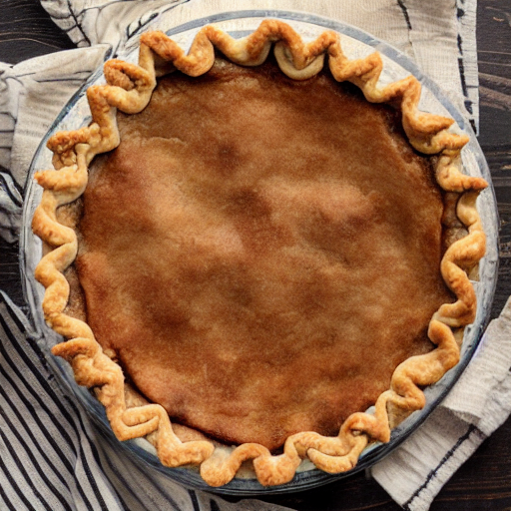
Recipes to fail
Exploration
"Data scientist girl who cook with a suit in a kitchen, artstation concept art"
Project timeline
Le MLOps est une aventure Humaine – Devoxx France 2023 – Guillaume Chervet
Notes:
Now, Elisabeth is done.

Slide 8

Recipes to fail
Exploration
Industrialization
"Data scientist girl who cook with a suit in a kitchen, artstation concept art"
"Developer waiter in t-shirt in a restaurant , artstation concept art"
Project timeline
Le MLOps est une aventure Humaine – Guillaume Chervet - 1er Décembre 2022
Notes:
I present you, Hicham, his role is to distribute the ingredients on the pizza dough.

Slide 9
Recipes to fail
Exploration
Industrialization
Hop
"Data scientist girl who cook with a suit in a kitchen, artstation concept art"
"Developer waiter in t-shirt in a restaurant , artstation concept art"
Project timeline
Le MLOps est une aventure Humaine – Devoxx France 2023 – Guillaume Chervet
Notes:
Now Elisabeth, sends the pizza dough and the ingredients to Hicham. As you can see on the left, Elisabeth forgot to give the ham to Hicham.

Slide 10
Recipes to fail
Exploration
Industrialization
"Developer waiter in t-shirt in a restaurant , artstation concept art"
Project timeline
Le MLOps est une aventure Humaine – Devoxx France 2023 – Guillaume Chervet
Notes:
So now, Hicham, it's his turn to play and it's up to him to spread the ingredients on the pizza dough. However, he realizes that the ham has been forgotten and he expected that Elisabeth would have pre-cut the ingredients. Unfortunately, he does not have any knife.
Hicham as a good developer does everything he can. He takes the ingredients and spreads them as he can on the pizza.

Slide 11
Recipes to fail
Exploration
Industrialization
Deployment & run
"Developer waiter in t-shirt in a restaurant , artstation concept art"
Project timeline
Le MLOps est une aventure Humaine – Guillaume Chervet - 1er Décembre 2022
Notes:
Good job for Hicham.

Slide 12
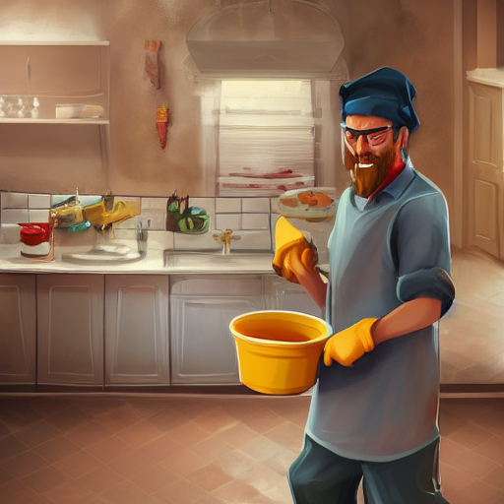
Recipes to fail
Exploration
Industrialization
Deployment & run
"Developer waiter in t-shirt in a restaurant , artstation concept art"
"Man who washes dishes in a kitchen, artstation concept art"
Project timeline
Le MLOps est une aventure Humaine – Devoxx France 2023 – Guillaume Chervet
Notes:
Now, I present you Khalid; it's our Ops. He is responsible for baking the pizza then to deliver it to the customers.

Slide 13
Recipes to fail
Exploration
Industrialization
Deployment & run
Hop
"Developer waiter in t-shirt in a restaurant , artstation concept art"
"Man who washes dishes in a kitchen, artstation concept art"
Project timeline
Le MLOps est une aventure Humaine – Guillaume Chervet - 1er Décembre 2022
Notes:
Hop, Hicham give the pizza to Khalid.

Slide 14
Recipes to fail
Exploration
Industrialization
Deployment & run
"Man who washes dishes in a kitchen, artstation concept art"
Project timeline
Le MLOps est une aventure Humaine – Devoxx France 2023 – Guillaume Chervet
Notes:
Damn, we forgot to give the instructions to Khalid. He doesn't know how to cook it (what temperature, and for how long). So, Khalid try to cook the pizza as he can.

Slide 15
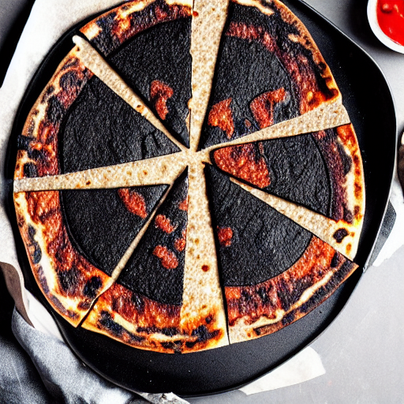
Recipes to fail
Exploration
Industrialization
Deployment & run
"Man who washes dishes in a kitchen, artstation concept art"
Project timeline
Le MLOps est une aventure Humaine – Devoxx France 2023 – Guillaume Chervet
Notes:
Unfortunately, now the pizza – without ham, and with badmy cut ingredients – is burnt. Good luck eating that!

Slide 16
Recipes to fail
Exploration
Industrialization
Deployment & run
1) Organize your teams to work in silo !
"Data scientist girl who cook with a suit in a kitchen, artstation concept art"
"Developer waiter in t-shirt in a restaurant , artstation concept art"
"Man who washes dishes in a kitchen, artstation concept art"
Project timeline
Le MLOps est une aventure Humaine – Devoxx France 2023 – Guillaume Chervet
Notes:
To sum up, here we have organized our team in silo, each role working separately, and also at the same time. It’s not a team mode. If you want to wreck your project, this is the right way to organize.
You should know that the very first choice of libraries from the start of the project has a direct impact on production. Not working together, not worrying about production from the beginning of the project, are silver bullets to make project fail.

Slide 17
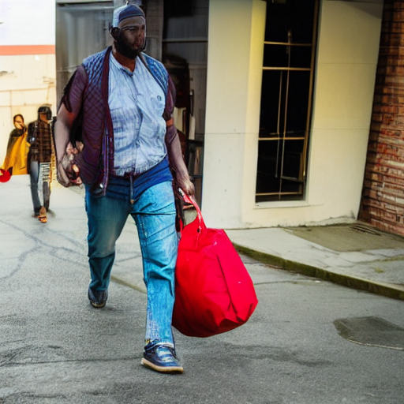
2) Come with wrong ingredients
Recipes to fail
"a man carrying a big bag"
Le MLOps est une aventure Humaine – Devoxx France 2023 – Guillaume Chervet
Notes:
Now we're going to set up the table for our customers. So, if you want to ruin a project it can be a very good idea not to focus on the user needs.
First example, on the driving license project, we were asked to read the documents in less than 10 seconds. When we started working on it, we deploy on production environment the very first algorithm that Data Scientists gave to us, the Splitter of PDF. We quickly realized that the times of one extraction took around 15 to 30 seconds, which was very problematic. The Data Scientists did not notice it because they work on overpowered machines which perform the operation very quickly.
Second example, when we were a little further on the project. We realized that some readings were very slow and clogged the systems. By looking a little more in detail at that the documents. We found that, in general, there were almost unreadable document event for a human. For this kind of case, it would have been a good idea to go see the users and to ask them if it would not be a better idea to report immediately that the document is not clean enough. It would have been better for the system and final users which wait 40 seconds before getting very bad results.

Slide 18

3) Forget customer needs
Recipes to fail
At the pizzeria
"set table with glass plates and cutlery on a table"
Le MLOps est une aventure Humaine – Devoxx France 2023 – Guillaume Chervet
Notes:
Now we're going to set up the table for our customers. So, if you want to ruin a project it can be a very good idea not to focus on the user needs.
First example, on the driving license project, we were asked to read the documents in less than 10 seconds. When we started working on it, we deploy on production environment the very first algorithm that Data Scientists gave to us, the Splitter of PDF. We quickly realized that the times of one extraction took around 15 to 30 seconds, which was very problematic. The Data Scientists did not notice it because they work on overpowered machines which perform the operation very quickly.
Second example, when we were a little further on the project. We realized that some readings were very slow and clogged the systems. By looking a little more in detail at that the documents. We found that, in general, there were almost unreadable document event for a human. For this kind of case, it would have been a good idea to go see the users and to ask them if it would not be a better idea to report immediately that the document is not clean enough. It would have been better for the system and final users which wait 40 seconds before getting very bad results.

Slide 19
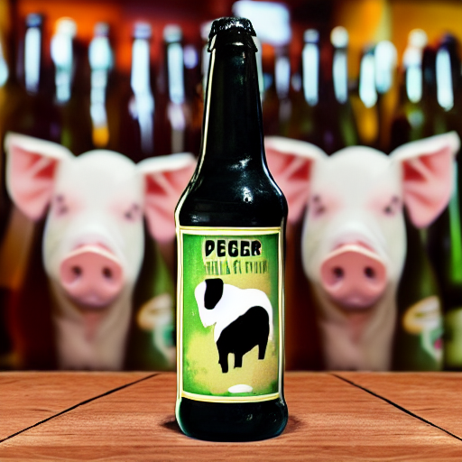
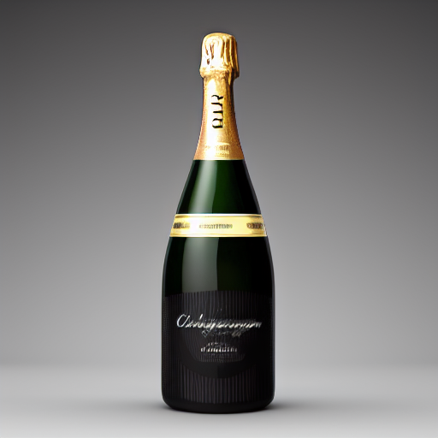
4) Use Deep Learning Everywhere
Recipes to fail
Deep Learning
Code classique
"bottle of beer with a pig on the label"
"bottle of champagne gold"
Le MLOps est une aventure Humaine – Devoxx France 2023 – Guillaume Chervet
Notes:
Now we're going to set up the table for our customers. So, if you want to ruin a project it can be a very good idea not to focus on the user needs.
First example, on the driving license project, we were asked to read the documents in less than 10 seconds. When we started working on it, we deploy on production environment the very first algorithm that Data Scientists gave to us, the Splitter of PDF. We quickly realized that the times of one extraction took around 15 to 30 seconds, which was very problematic. The Data Scientists did not notice it because they work on overpowered machines which perform the operation very quickly.
Second example, when we were a little further on the project. We realized that some readings were very slow and clogged the systems. By looking a little more in detail at that the documents. We found that, in general, there were almost unreadable document event for a human. For this kind of case, it would have been a good idea to go see the users and to ask them if it would not be a better idea to report immediately that the document is not clean enough. It would have been better for the system and final users which wait 40 seconds before getting very bad results.

Slide 20



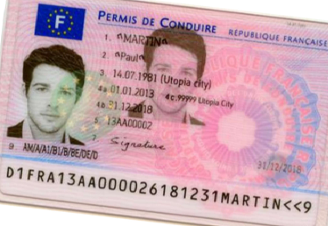

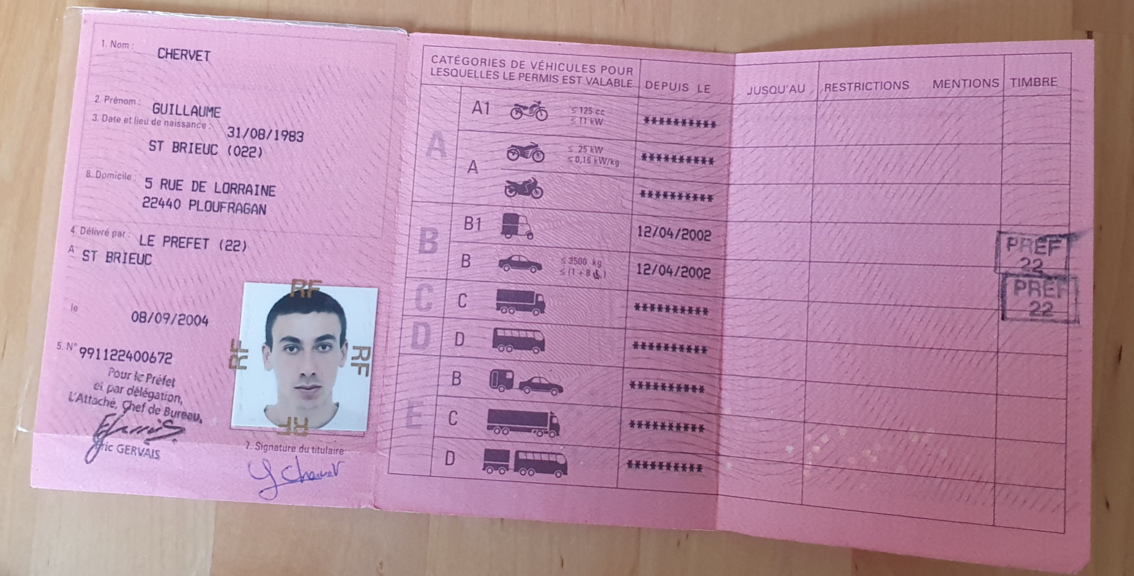
4) Use Deep Learning Everywhere
Recipes to fail
4 Go
5,5 Go
512 Mo
Orientation
Rotation
Homography
1 s
3 s
0,5 s
4 Go
5,5 Go
512 Mo
Orientation
Rotation
Homography
1 s
3 s
0,5 s
Legend :
5,5 Go
512 Mo
ML + code
Orientation
Homography
1 s
0,5 s
Only code
Le MLOps est une aventure Humaine – Devoxx France 2023 – Guillaume Chervet
Notes:
Now we're going to set up the table for our customers. So, if you want to ruin a project it can be a very good idea not to focus on the user needs.
First example, on the driving license project, we were asked to read the documents in less than 10 seconds. When we started working on it, we deploy on production environment the very first algorithm that Data Scientists gave to us, the Splitter of PDF. We quickly realized that the times of one extraction took around 15 to 30 seconds, which was very problematic. The Data Scientists did not notice it because they work on overpowered machines which perform the operation very quickly.
Second example, when we were a little further on the project. We realized that some readings were very slow and clogged the systems. By looking a little more in detail at that the documents. We found that, in general, there were almost unreadable document event for a human. For this kind of case, it would have been a good idea to go see the users and to ask them if it would not be a better idea to report immediately that the document is not clean enough. It would have been better for the system and final users which wait 40 seconds before getting very bad results.

Slide 21
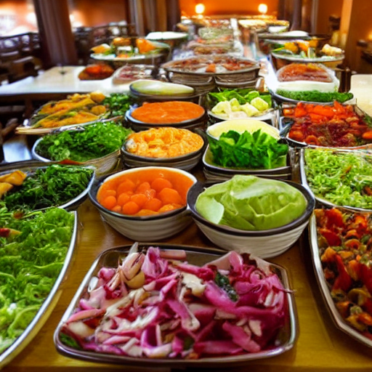
5) Missed to industrialize the training code
Recipes to fail
"salad buffet in a restaurant"
Le MLOps est une aventure Humaine – Devoxx France 2023 – Guillaume Chervet
Notes:
Now we're going to set up the table for our customers. So, if you want to ruin a project it can be a very good idea not to focus on the user needs.
First example, on the driving license project, we were asked to read the documents in less than 10 seconds. When we started working on it, we deploy on production environment the very first algorithm that Data Scientists gave to us, the Splitter of PDF. We quickly realized that the times of one extraction took around 15 to 30 seconds, which was very problematic. The Data Scientists did not notice it because they work on overpowered machines which perform the operation very quickly.
Second example, when we were a little further on the project. We realized that some readings were very slow and clogged the systems. By looking a little more in detail at that the documents. We found that, in general, there were almost unreadable document event for a human. For this kind of case, it would have been a good idea to go see the users and to ask them if it would not be a better idea to report immediately that the document is not clean enough. It would have been better for the system and final users which wait 40 seconds before getting very bad results.

Slide 22

6) Messy quality code
Recipes to fail
Bolognese spagetti plate with cheese
Le MLOps est une aventure Humaine – Devoxx France 2023 – Guillaume Chervet
Notes:
Now we're going to set up the table for our customers. So, if you want to ruin a project it can be a very good idea not to focus on the user needs.
First example, on the driving license project, we were asked to read the documents in less than 10 seconds. When we started working on it, we deploy on production environment the very first algorithm that Data Scientists gave to us, the Splitter of PDF. We quickly realized that the times of one extraction took around 15 to 30 seconds, which was very problematic. The Data Scientists did not notice it because they work on overpowered machines which perform the operation very quickly.
Second example, when we were a little further on the project. We realized that some readings were very slow and clogged the systems. By looking a little more in detail at that the documents. We found that, in general, there were almost unreadable document event for a human. For this kind of case, it would have been a good idea to go see the users and to ask them if it would not be a better idea to report immediately that the document is not clean enough. It would have been better for the system and final users which wait 40 seconds before getting very bad results.

Slide 23
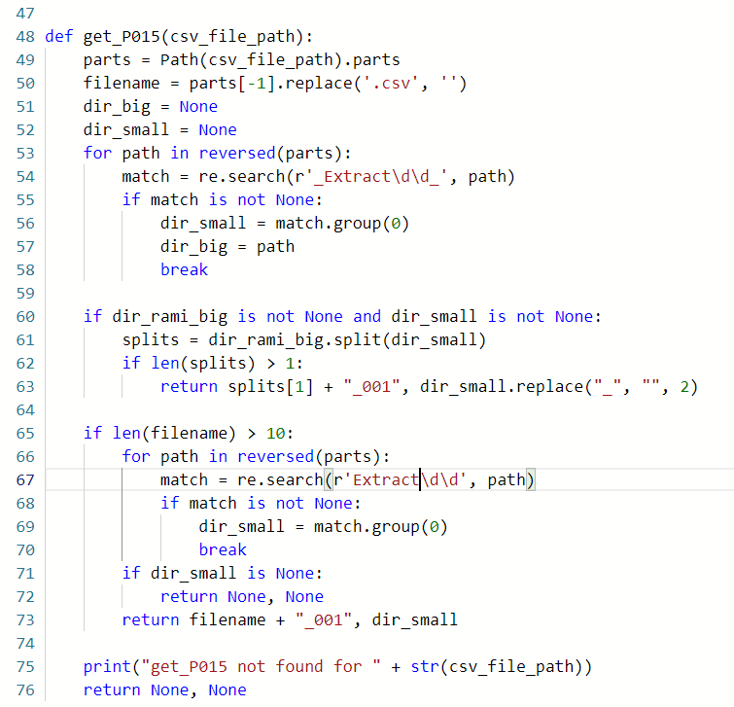
6) Messy quality code
Recipes to fail
Le MLOps est une aventure Humaine – Devoxx France 2023 – Guillaume Chervet
Notes:
Now we're going to set up the table for our customers. So, if you want to ruin a project it can be a very good idea not to focus on the user needs.
First example, on the driving license project, we were asked to read the documents in less than 10 seconds. When we started working on it, we deploy on production environment the very first algorithm that Data Scientists gave to us, the Splitter of PDF. We quickly realized that the times of one extraction took around 15 to 30 seconds, which was very problematic. The Data Scientists did not notice it because they work on overpowered machines which perform the operation very quickly.
Second example, when we were a little further on the project. We realized that some readings were very slow and clogged the systems. By looking a little more in detail at that the documents. We found that, in general, there were almost unreadable document event for a human. For this kind of case, it would have been a good idea to go see the users and to ask them if it would not be a better idea to report immediately that the document is not clean enough. It would have been better for the system and final users which wait 40 seconds before getting very bad results.

Slide 24


7) Split train and production code on different git
Recipes to fail
"a pinch of salt"
Le MLOps est une aventure Humaine – Devoxx France 2023 – Guillaume Chervet
Notes:
Now we're going to set up the table for our customers. So, if you want to ruin a project it can be a very good idea not to focus on the user needs.
First example, on the driving license project, we were asked to read the documents in less than 10 seconds. When we started working on it, we deploy on production environment the very first algorithm that Data Scientists gave to us, the Splitter of PDF. We quickly realized that the times of one extraction took around 15 to 30 seconds, which was very problematic. The Data Scientists did not notice it because they work on overpowered machines which perform the operation very quickly.
Second example, when we were a little further on the project. We realized that some readings were very slow and clogged the systems. By looking a little more in detail at that the documents. We found that, in general, there were almost unreadable document event for a human. For this kind of case, it would have been a good idea to go see the users and to ask them if it would not be a better idea to report immediately that the document is not clean enough. It would have been better for the system and final users which wait 40 seconds before getting very bad results.

Slide 25
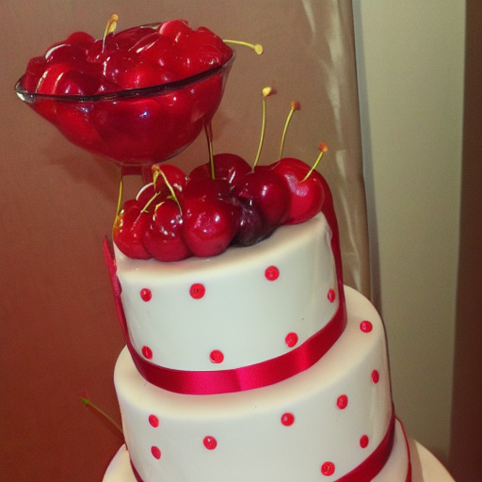
8) Let the data drift happen
Recipes to fail
"cherry on the cake"
Le MLOps est une aventure Humaine – Devoxx France 2023 – Guillaume Chervet
Notes:
Now we're going to set up the table for our customers. So, if you want to ruin a project it can be a very good idea not to focus on the user needs.
First example, on the driving license project, we were asked to read the documents in less than 10 seconds. When we started working on it, we deploy on production environment the very first algorithm that Data Scientists gave to us, the Splitter of PDF. We quickly realized that the times of one extraction took around 15 to 30 seconds, which was very problematic. The Data Scientists did not notice it because they work on overpowered machines which perform the operation very quickly.
Second example, when we were a little further on the project. We realized that some readings were very slow and clogged the systems. By looking a little more in detail at that the documents. We found that, in general, there were almost unreadable document event for a human. For this kind of case, it would have been a good idea to go see the users and to ask them if it would not be a better idea to report immediately that the document is not clean enough. It would have been better for the system and final users which wait 40 seconds before getting very bad results.

Slide 26

9) Focus on statistics and forget the rest
Recipes to fail
"one coffee on a table"
Le MLOps est une aventure Humaine – Devoxx France 2023 – Guillaume Chervet
Notes:
Now we're going to set up the table for our customers. So, if you want to ruin a project it can be a very good idea not to focus on the user needs.
First example, on the driving license project, we were asked to read the documents in less than 10 seconds. When we started working on it, we deploy on production environment the very first algorithm that Data Scientists gave to us, the Splitter of PDF. We quickly realized that the times of one extraction took around 15 to 30 seconds, which was very problematic. The Data Scientists did not notice it because they work on overpowered machines which perform the operation very quickly.
Second example, when we were a little further on the project. We realized that some readings were very slow and clogged the systems. By looking a little more in detail at that the documents. We found that, in general, there were almost unreadable document event for a human. For this kind of case, it would have been a good idea to go see the users and to ask them if it would not be a better idea to report immediately that the document is not clean enough. It would have been better for the system and final users which wait 40 seconds before getting very bad results.

Slide 27

Recipes to fail
Recipes to fail
10) Write a big check
"invoice made of gold"
Le MLOps est une aventure Humaine – Devoxx France 2023 – Guillaume Chervet
Notes:
Time to pay the bill!
You don't have to wait for someone to come to you to start paying attention if the project is too expensive.
The planet has limited resources, so please, you should always think about consuming as few resources as possible.
If your project is too expensive, it may be stopped.

Slide 28
Today Agenda
Recipes to fail an ML project
How to stack the odds in your favor ?
Notes:
In this part we are going to give feedbacks based on different experiences. This allowed us to learn what NOT to do.
To make it fun, we are going to open a pizzeria and we are going to organize to serve pizzas to our customers. We're going to put everything in place to make our pizzeria fails to deliver a good meal.

Slide 29


Slide 30
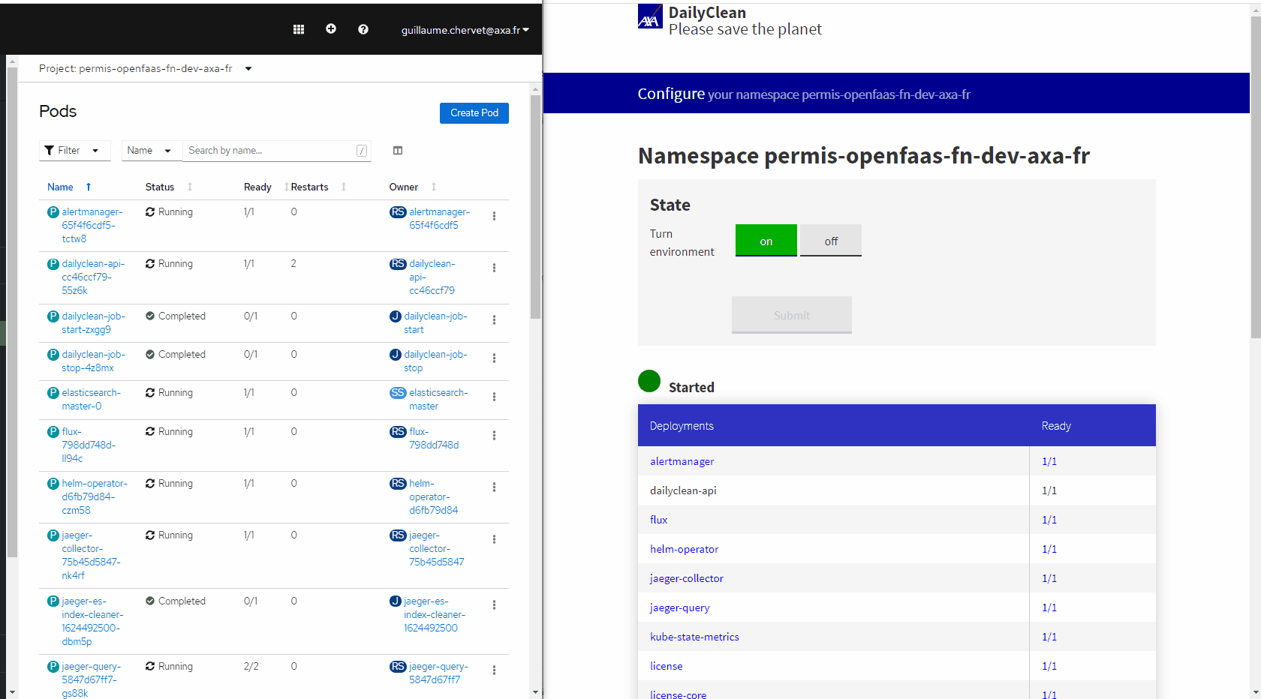
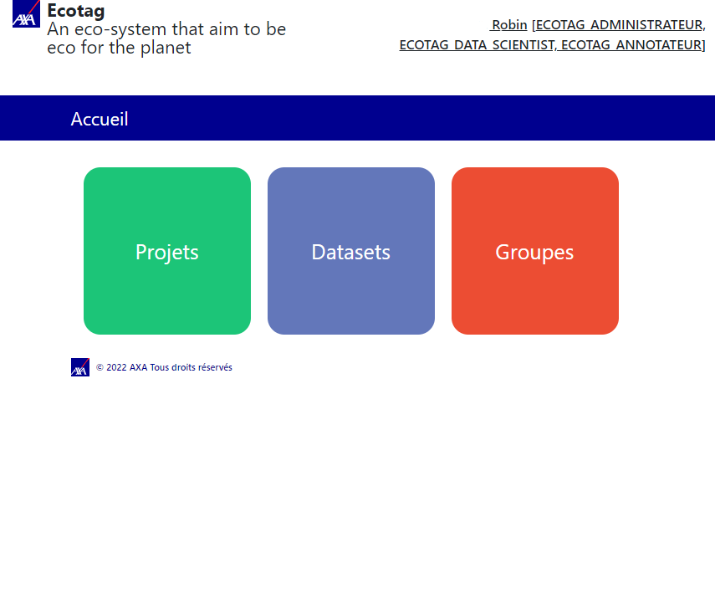
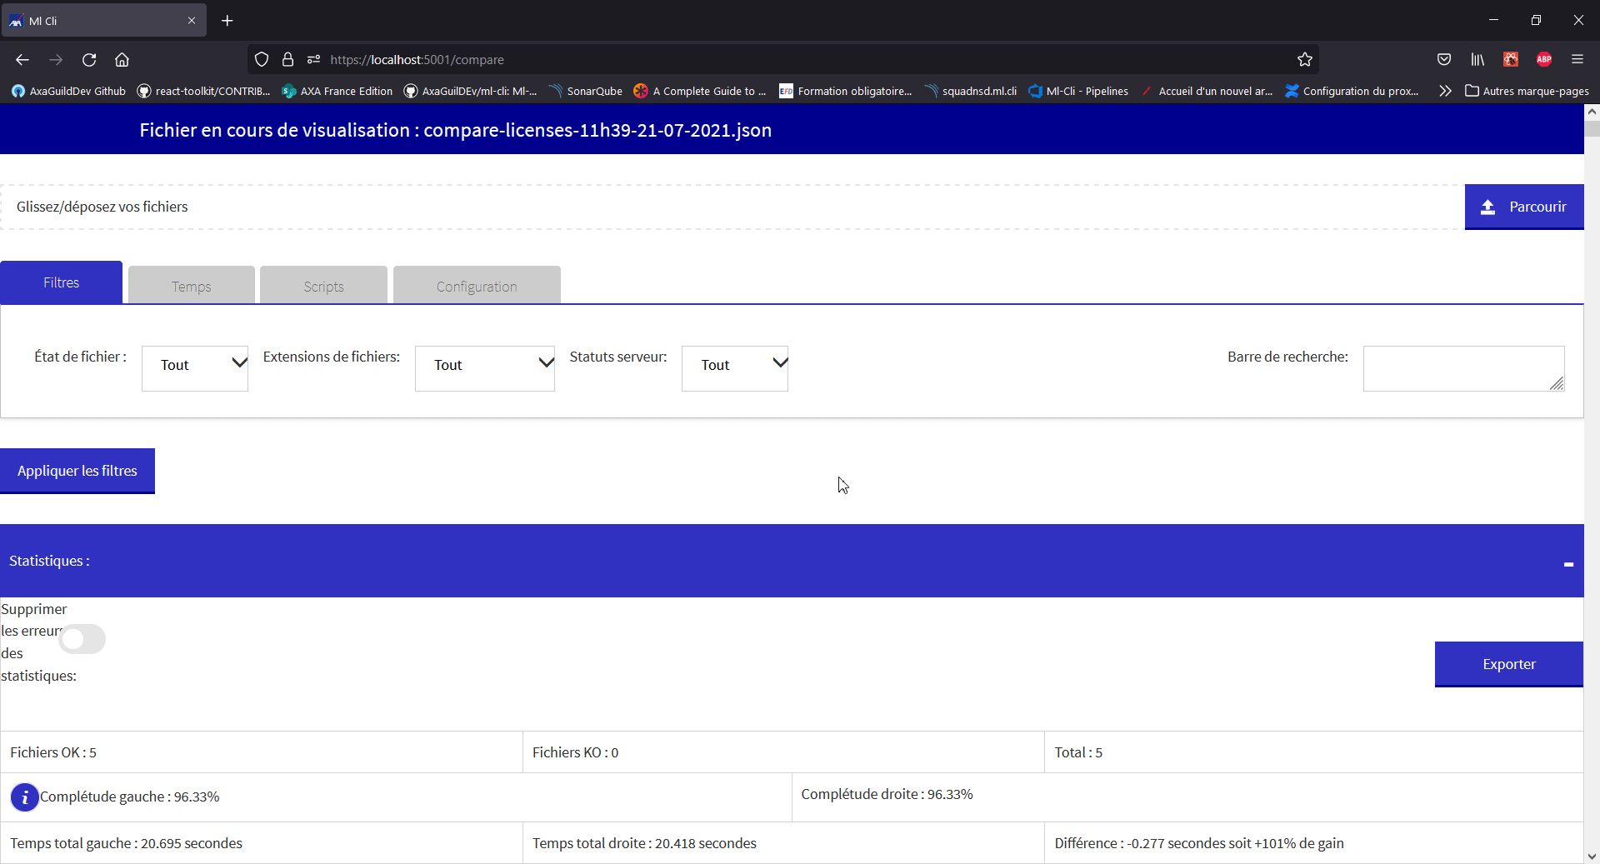
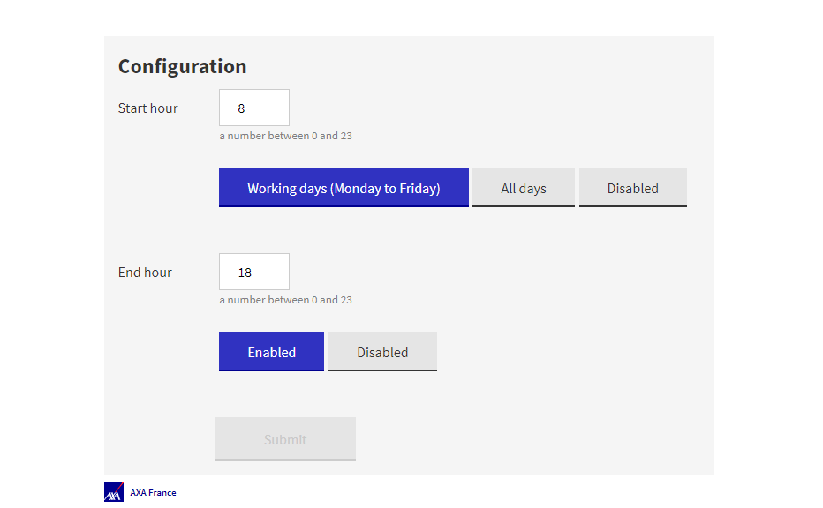

Open Source
Ecotag
&
ml-cli
Dailyclean
SlimFaaS
Le MLOps est une aventure Humaine – Devoxx France 2023 – Guillaume Chervet
Notes:
MLOPS is not centered on tools, however thanks to our projects, we have been able to set up tools and open source them. It is a pleasure to share them with you.
The daily clean allows us to automatically shut down Kubernetes environment.
Ecotag allows us to make labelling and comply with GDPR rules.
ml-cli is our integration test tool.

Slide 31

Conclusion
"three people hugging"
Le MLOps est une aventure Humaine – Devoxx France 2023 – Guillaume Chervet
Notes:
To conclude, MLOPS is above all a culture of sharing.
Today we have projects that are at the top of the top of the complexity and if we do not put everything in place to help experts to work together.
To understand that the problem of one is the problem of the other.
It can't work.
A production ready project should also be a final focus.
The key to success comes in this sharing and working together.
Comprendre le droit à l’erreur.
Dur avec le code doux avec les gens

Slide 32

Thank you ☺
"thank and hug the public in a theater"
Le MLOps est une aventure Humaine – Devoxx France 2023 – Guillaume Chervet
Notes:
To conclude, MLOPS is above all a culture of sharing.
Today we have projects that are at the top of the top of the complexity and if we do not put everything in place to help experts to work together.
To understand that the problem of one is the problem of the other.
It can't work.
A production ready project should also be a final focus.
The key to success comes in this sharing and working together.
Comprendre le droit à l’erreur.
Dur avec le code doux avec les gens

